Slide 1
Lead Scoring Case Study
By: Hritik Yadav Manisha Rajput Pooja Aher

Slide 2
Problem Statement
An online education company named X Education wants to know its potential lead (unpaid customers) which can convert into paid customers. The company wants a model which assign a lead score to each lead based on chances of its converting to paid customer. Higher the lead score, higher the chance of conversion.

Slide 3
Approach for the analysis
Reading the data
Data cleaning
Data transformation
Train-Test split and feature scaling
Model building and feature selection using RFE
Calculating the model evaluation metrics
Plotting ROC and finding optimal cutoff point
Calculating the precision and recall metrics
Prediction on test set

Slide 4
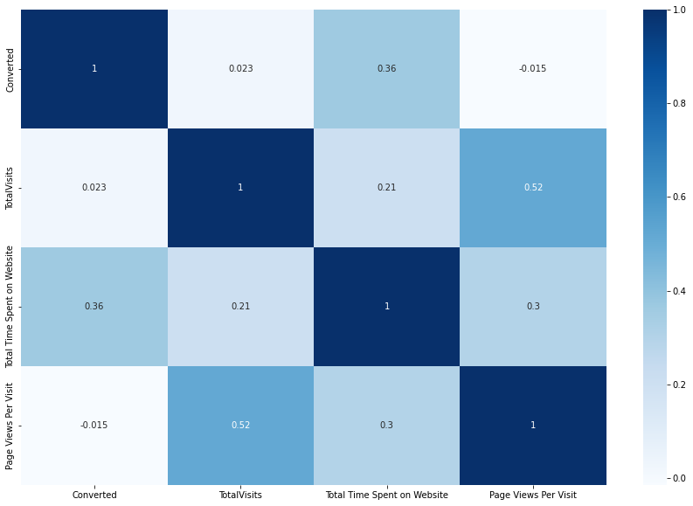
Correlation
From the correlation heat map, we can see that ‘page views per visit’ has high correlation with ‘total visits’.

Slide 5
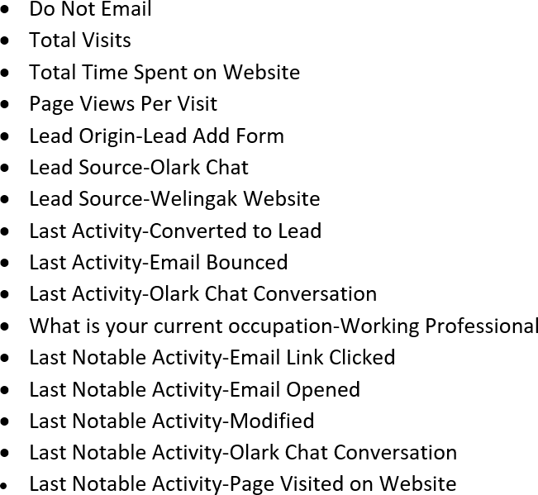
Variables Impacting the conversion rate

Slide 6
Model Building
We first build the model with all dummy variables but after that we used RFE to select 20 variables and calculated p value. We then eliminate variables one by one which has p value more that 0.05. After 6 iterations we got our final model where every variable has p value less than 0.05 and VIF value less than 3.

Slide 7
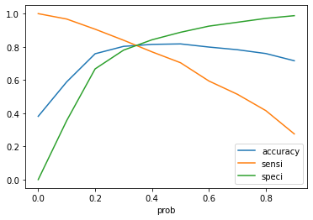
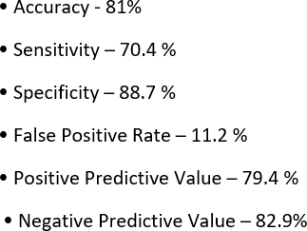
Model Evaluation - Sensitivity and Specificity on Train Data Set
The graph depicts an optimal cut off of 0.37 based on Accuracy, Sensitivity and Specificity

Slide 8
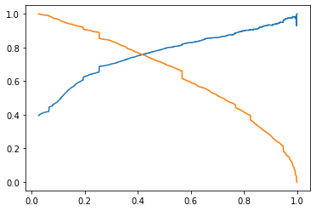

Model Evaluation - Precision and Recall on Train Dataset
The graph depicts an optimal cut off of 0.37 based on Accuracy, Sensitivity and Specificity

Slide 9
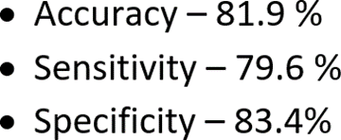
Model Evaluation – Sensitivity and Specificity on Test Dataset

Slide 10
Conclusion
We have considered the optimal cut off based on Sensitivity and Specificity for calculating the final prediction.
Accuracy, Sensitivity and Specificity values of test set are around 81%, 79% and 82%.
The top 3 variables that contribute for lead getting converted in the model are:
- Total Visits
- Total Time Spent on Website
- Lead Origin-Lead Add Form
In business terms, this model has an ability to go along with the company’s requirements in coming future.
Hence overall this model seems to be good.

Slide 11
Thank You!!

